Slide 1



Slide 2



Lauren Busch
Vohn Watts
Director of Product Education
VP, Nutritional Education

Slide 3


What Is Foundational Wellness

Slide 4









PROACTIVE
MEDICAL CARE
HEALTHCARE
INFORMED SELF-CARE
Foundational
Wellness
with dōTERRA
REDUCE TOXICITY
REST & MANAGE STRESS
LIFESTYLE
MOVEMENT & METABOLISM
NUTRITION & DIGESTION

Slide 5

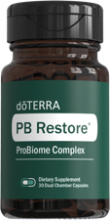

Foundational
Wellness
with dōTERRA
PROACTIVE
MEDICAL CARE
INFORMED SELF-CARE
HEALTHCARE
REDUCE TOXICITY
REST & MANAGE STRESS
LIFESTYLE
MOVEMENT & METABOLISM
NUTRITION & DIGESTION

Slide 6







Superfood Blend
Promotes foundational health and vitality with phytonutrients, antioxidants, vitamins, minerals, and other nutrients.*
Cellular
Support Blend
Biotransformation
Blend
Supports cellular health
and antioxidant defenses.*
Provides biologically enhanced nutrients via biotransformation.*
Nutrition Blend
Bioavailability
Boosting Blend
Includes plant-derived vitamins, minerals, and essential cofactors.
Enhances absorption and retention of micronutrients, according to preclinical research.*
*These statements have not been evaluated by the Food and Drug Administration.
These products are not intended to diagnose, treat, cure, or prevent any disease.

Slide 7







Bioavailability is
what makes it unique!
Essential Oils
Wholefood Vitamins
Liposomal technology
Digestive Enzymes/Probiotics
Methylated B Vitamins

Slide 8
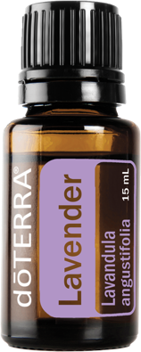
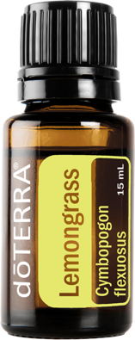



Essential Oil Blend for Bioavailability

Slide 9

Whole-Food Vitamins

Slide 10
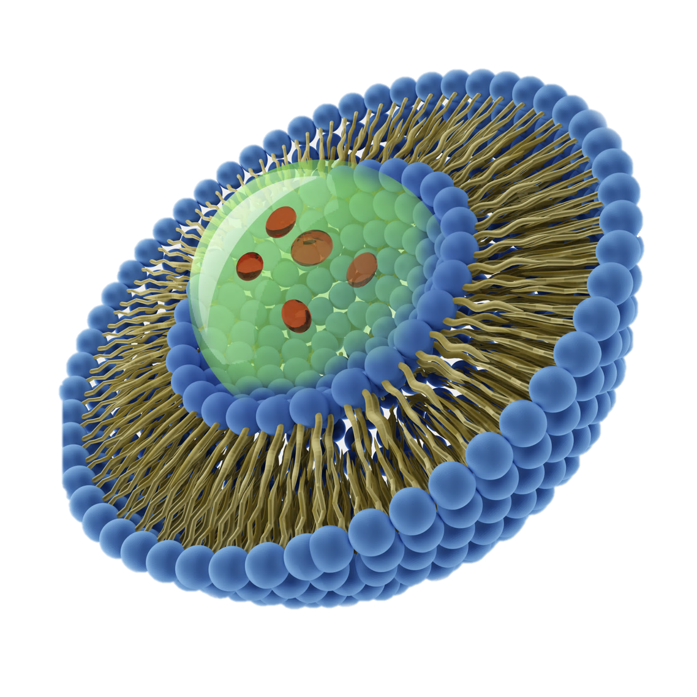
Liposomal Technology
What is Liposomal Technology?
Liposomal delivery is an advanced nutrient-delivery system that increases the benefits of supplementation. Its unique method offers significant advantages when compared to others, such as capsules and tablets. Promising superior bioavailability and better absorption.

Slide 11

Digestive Enzymes &
Probiotics

Slide 12



MTHFR &
B Vitamins

Slide 13

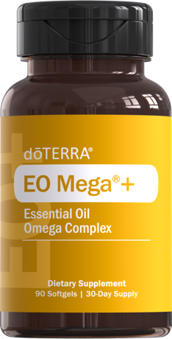
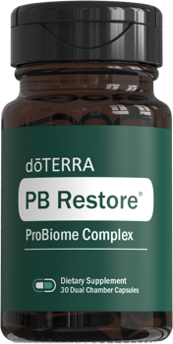
Foundational Wellness
Bundle

Slide 14



Who is it for?
How do I dose it?
Daily
Routine
When should I take it?
Can I combine it with other products?
i.e. VMG+, Advantage, Recharge, PB Assist+
Stacking Foundational Wellness bundle w/ individualized solutions

Slide 15



Bio-individuality is the idea that each person has unique health and nutritional needs.
There is no "one-size-fits-all" approach to health and nutrition.

Slide 16
This is because our bodies react differently to various foods, habits, and other factors,
such as our genetics, environment, and lifestyle.
—Lauren Busch

Slide 17
Foundational Wellness
Bundle
*These statements have not been evaluated by the Food and Drug Administration.
These products are not intended to diagnose, treat, cure, or prevent any disease.

Slide 18

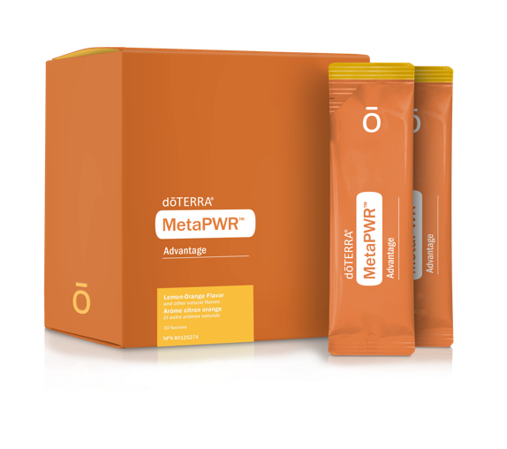


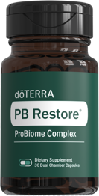

Foundational Wellness
Uplevel
*These statements have not been evaluated by the Food and Drug Administration.
These products are not intended to diagnose, treat, cure, or prevent any disease.

Slide 19
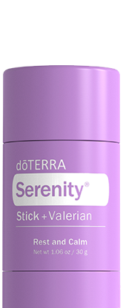
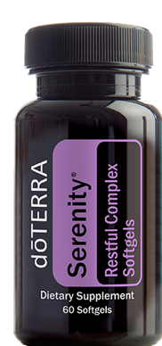
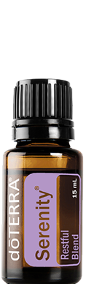
Foundational Wellness
Sleep
*These statements have not been evaluated by the Food and Drug Administration.
These products are not intended to diagnose, treat, cure, or prevent any disease.

Slide 20
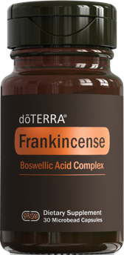

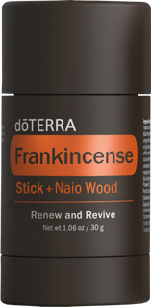
Foundational Wellness
Cellular Health
*These statements have not been evaluated by the Food and Drug Administration.
These products are not intended to diagnose, treat, cure, or prevent any disease.

Slide 21

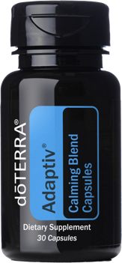

Foundational Wellness
Stress
*These statements have not been evaluated by the Food and Drug Administration.
These products are not intended to diagnose, treat, cure, or prevent any disease.

Slide 22
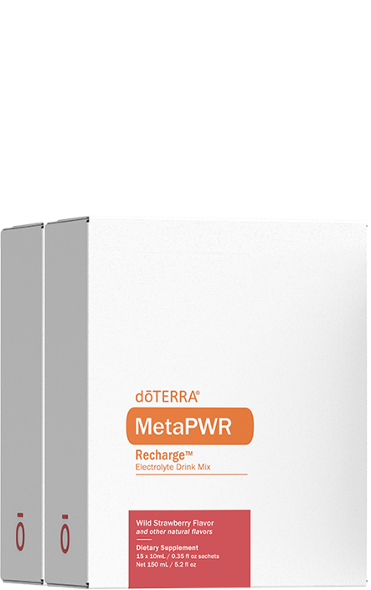
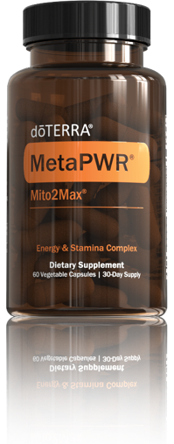
Foundational Wellness
Energy
*These statements have not been evaluated by the Food and Drug Administration.
These products are not intended to diagnose, treat, cure, or prevent any disease.

Slide 23
Foundational Wellness
Bundle
$149.50
WHOLESALE
125
PV
*These statements have not been evaluated by the Food and Drug Administration.
These products are not intended to diagnose, treat, cure, or prevent any disease.

Slide 24


Education Materials

